Slide 1
Excel
Charts
How to Create Charts in MS Excel
How to Create Charts in MS Excel

Slide 2
Introduction
Microsoft Excel is a powerful spreadsheet tool. Charts help visualize data clearly and quickly. Excel offers many chart types to suit various data needs.

Slide 3
Types of Charts
Available
Excel provides common charts like Column, Bar, Pie, and Line. Each type serves different purposes in presenting data trends and comparisons effectively.

Slide 4
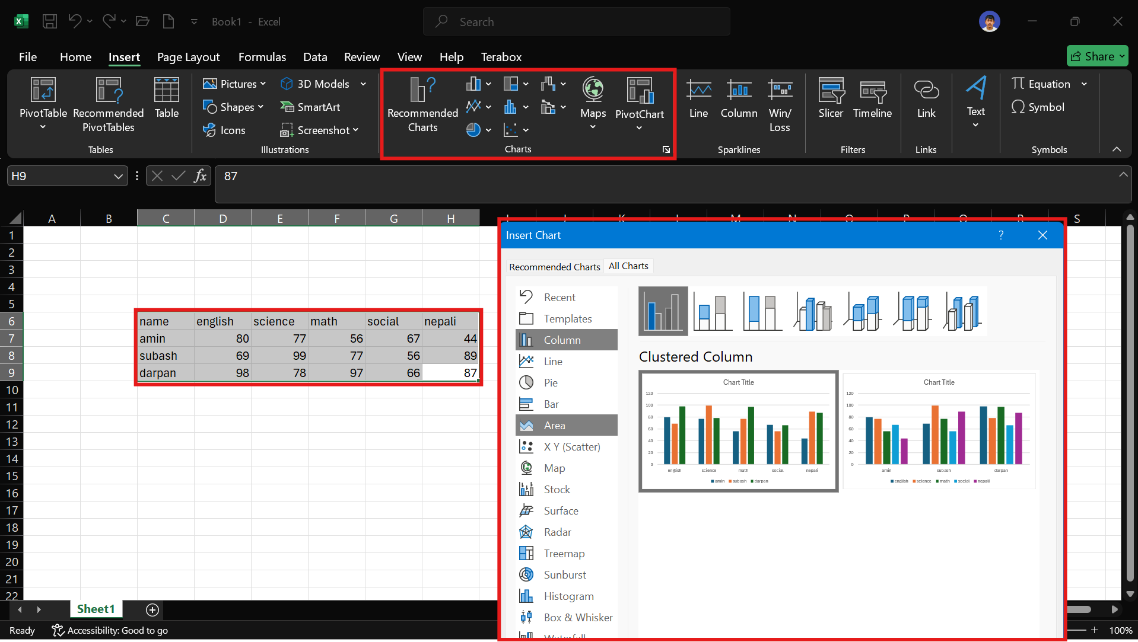
Creating and Customizing
Charts

Slide 5
Entering and Selecting
Data
Start by entering your data clearly in rows and columns.
Select the range carefully, including headers, to ensure your chart is accurate and well-labeled.
Proper data organization is key to successful chart creation.

Slide 6
Customizing Chart Appearance and
Labels
Enhance your chart by adding a descriptive title and adjusting colors to improve readability. Include data labels for clarity. Customization helps make your chart visually appealing and easier to interpret at a glance.

Slide 7
Conclusions
Creating charts in Excel mainly enhances data visualization. Proper data entry, choosing the right chart type, and customizing appearance are essential steps. Charts improve presentations and make data-driven insights clear and accessible.

Slide 8
Thank You ☺
If you have any questions, Feel Free to ask.

